Slide 1
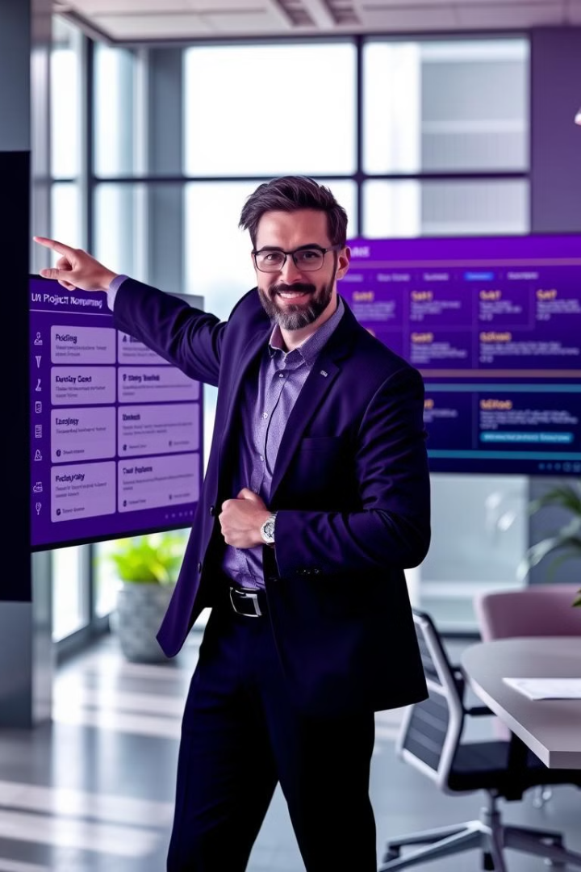
Tracking and Controlling in Project Management
Tracking and controlling in project management is crucial for ensuring that projects stay on track, meet goals, and adhere to deadlines, budgets, and quality standards. This process involves tracking progress, identifying potential issues early, and taking corrective actions to ensure project success.

Slide 2
Important Aspects of Tracking and Controlling
Progress Tracking
Performance Measurement
Quality Management
Monitor project status using Gantt charts or a project dashboard. Maintain complete records of completed tasks, consumed resources, and time taken.
Use KPIs like Cost Performance Index (CPI) and Schedule Performance Index (SPI). Track efficiency, productivity, and quality of deliverables.
Carry out regular quality checks to ensure that the deliverables meet the predetermined standards. Carry out audits and reviews at critical stages. Use feedback loops to improve both processes and results.
Change Control
Stakeholder Communication
Risk and Issue Management
Implement a formal process of change management that deals with scope, budget, and schedule. Evaluate how changes would impact the objectives of the project. Obtain approval from stakeholders before any changes.
Inform stakeholders of project status, risks, and changes on a regular basis. Use easy-to-read and seemingly simple reporting, such as dashboards, graphs, and summaries. Host regular meetings to answer questions and ensure that everything is clear.
Find and evaluate risks all the time during the project.
Maintain a risk register that captures possible problems and remedies. Handle problems early with set backup plans.

Slide 3
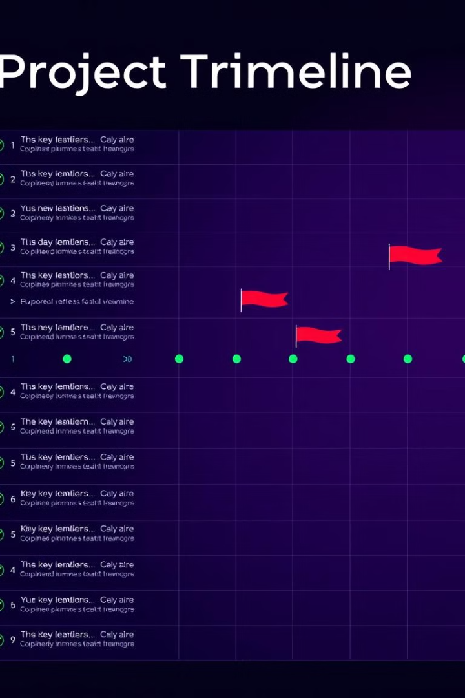
Processes in Tracking and Controlling
1
Data Collection and Reporting
2
Variance Analysis
Collect real-time information about resource use, progress, and finances.
Compare actual progress versus the project plan. Identify deviations and their causes.
3
Forecasting
4
Schedule Control
Use past data and trends to predict future project performance. Adjust resources or timelines based on predictions.
Check how quickly tasks are done and change schedules for any delays. Use tools that show the project timeline to see progress and find problems.
5
Cost Control
6
Quality Assurance
Track expenses in real time against budget baselines. Introduce corrective action in the form of fund reallocation and reduction of scope where budget is overrun in a project.
Inspection, testing, and reviews to check quality. Document lessons learned and ensure that they don't happen in a future project.

Slide 4


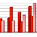
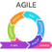

Techniques and Tools
Project Management Software
Examples: Microsoft Project, Asana, Jira, Trello
Dashboards and Reporting Tools
Show real-time visuals of KPIs, timelines, and budgets.
Agile Monitoring Techniques
In Agile projects, use burndown charts, velocity charts, and cumulative flow diagrams. - Quickly change plans to accommodate repeating development cycles.
Risk Management Tools
Software like Primavera Risk Analysis helps assess and reduce risks.

Slide 5
Advantages of Effective Tracking and Controlling
1
Early Risk Detection
Finds potential problems before they become serious. Helps to respond early, lowering negative effects.
2
Better Resource Use
Ensures resources are used effectively, preventing over or underutilization.
3
Saving Money and Time
Reduces delays and unnecessary costs. Ensures deliverables are delivered on time and within budget.
Better Stakeholder Trust
4
Open communication leads to the establishment of trust among stakeholders.Regular updates ensure that everyone is heading in the right direction concerning project goals.
Quality Check
5
It ascertains that deliverables meet or better expectations. Increases customer satisfaction and project success.

Slide 6






Best Practices for Effective Tracking and Controlling
Define Clear Baselines
Establish clear scope, cost, and schedule standards at the start of the project.
Real-Time Monitoring Tools
Acquire automated software to ensure timely and accurate data collection.
Progress Reviews
Schedule regular reviews to assess performance and resolve issues.
Promote Collaboration
Clearly, encourage the team and stakeholders to communicate eloquently.
Continuous Learning
Use the learnings from past projects to make monitoring practices better.

Slide 7

Challenges in Tracking and Controlling
Data Overload: Handling large amounts of data can overwhelm teams and hide important insights.
Dynamic Environments: Frequent changes in project goals or objectives make monitoring harder.
Limited Resources: Poor budgets or insufficient staff members make monitoring and changes difficult.
Resistance to change: It is the unwillingness of the team members or stakeholders to use new tools or processes.
Poor Tools or Training: This situation arises when the right tools or skills are not there, thus making monitoring less effective.

Slide 8
Thank You

